Slide 1
Innovative, Rationale and Differential Theory

Slide 2
Behavioural theory holds that psychological events can be described and explained in terms of observable behaviour and its associations with environmental stimuli and occurrences.
The three major types of learning described by behavioural psychology are
Classical conditioning,
Operant conditioning, and
Observational learning.
Skinner's behaviour theory was based on:
Human behaviour follows 'laws' and that the causes of human behaviour are something outside of a person, something in their environment. He believed that these environmental 'causes' of behaviour could always be observed and studied.

Slide 3
Humanism is a paradigm / philosophy / pedagogical approach that believes learning is viewed as a personal act to fulfil one’s potential.
Key proponents of humanism include Carl Rogers and Abraham Maslow. A primary purpose of humanism is the development of self-actualized, autonomous people.
In humanism, learning is student centered and personalized, and the educator’s role is that of a facilitator. Affective and cognitive needs are key, and the goal is to develop self-actualized people in a cooperative, supportive environment.

Slide 4
Cognitive learning focuses on helping you learn how to maximize your brain's potential. It makes it easier for students to connect new information with existing ideas hence deepening his/her memory and retention capacity.
Encouraging discussions about what is being taught. Helping students explore and understand how ideas are connected. Asking students to justify and explain their thinking. Using visualizations to improve students' understanding and recall.

Slide 5

Teaching Techniques to address learning styles as Activists
Brain storming
Problem solving
Group discussion
Puzzles
Competition
Role-play
Engineering Students as Activists! “I'll try anything once”
Learn best when involved in new experience:
‘learn by doing. Activists need to get their hands dirty, to dive in, both feet first. Have an open-minded approach to learning, involving themselves fully and without bias in new experiences’ (Honey, P. & Mumford, A. (1982) Manual of Learning Styles London: P Honey )

Slide 6

Peter Honey and Alan Mumford (1982) identified four distinct learning styles or preferences: Activists, Reflectors, Theorists and Pragmatists.
Honey and Mumford’s Learning Style Questionnaire (LSQ) has been proposed as an alternative for Kolb’s Experiential Learning Style Model (Figure. 1).
Honey and Mumford’s approach has been salutary in emphasizing that we all do learn in different ways and that uniform approaches to education and training, whether they be based on talk and chalk, experiential exercises or, indeed, distance learning, will not be suitable for every individual.

Slide 7
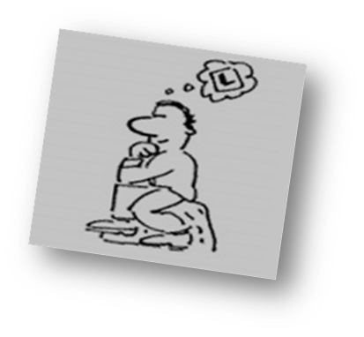
Humanities Students as Reflectors
“It’s good to be cautious”
Learn by observing and thinking through what happened:
“a process of thinking back on, reworking, searching for
meaning in experience” (Boud, D, Keogh, R, and Walker, D, 1985)
Given time to stand back, think and investigate before acting or commenting.
  Presented with an overview of all the theories available on a particular topic and given time to review what happened once action has been taken.
“Critical thinking is the intellectually disciplined
process of actively and skillfully conceptualizing,
applying, analyzing, synthesizing, and/or evaluating
information gathered from, or generated by, observation,
experience, reflection, reasoning, or
communication, as a guide to belief and action”
(Elder and Richard, 2009)

Slide 8
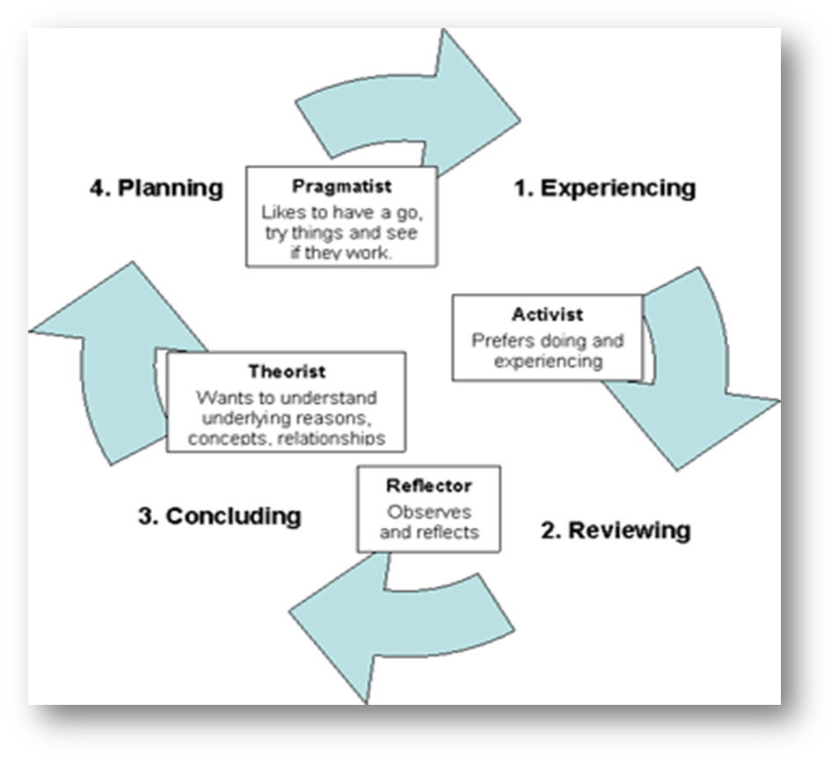
Honey and Mumford’s Learning Sequence. In essence, people learn from experience, however, the experience should be reviewed through a particular sequence.

Slide 9
Law students as Theorists “If it’s logical, it’s good”
Theorists learn best when the learning activity is backed by concepts that form a theory. They prefer structured learning. They like:
Problem Based Leaning (PBL)
Logical Legal Conclusions: “Legal rules seem to be different from principles in that their application guarantees their conclusions.” (Hage 2001 p.83)
Case law: Through legal principle and application: “Legal rules are principles which block the operation of all competing principles.” (Hage 2001 p.83)
Analysis of complex scenarios
Tutorial learning experience can be improved by:
Promoting critical analysis skills in PBL activities.
By developing your style, you will be
Better at questioning and probing inconsistencies and weaknesses in people’s arguments.
More interested in relating your actions to an overall plan.
More disciplined with tidier, more organised ways of working.
More tolerant of models and theories, explaining their potential relevance to your work.

Slide 10
Financial management Students as Pragmatists
“There is always a better way”
Pragmatists need to be able to see how to put the learning into practice in the real world. They like:
Case studies
Problem solving
Discussions
Enhancements can be made to tutorials and blackboard to introduce
additional elements of:
Interactive learning
Problem- based learning
How learning style can be applied at University:
The most direct application of the model is to ensure that teaching activities give full value to each stage of the process

Slide 11
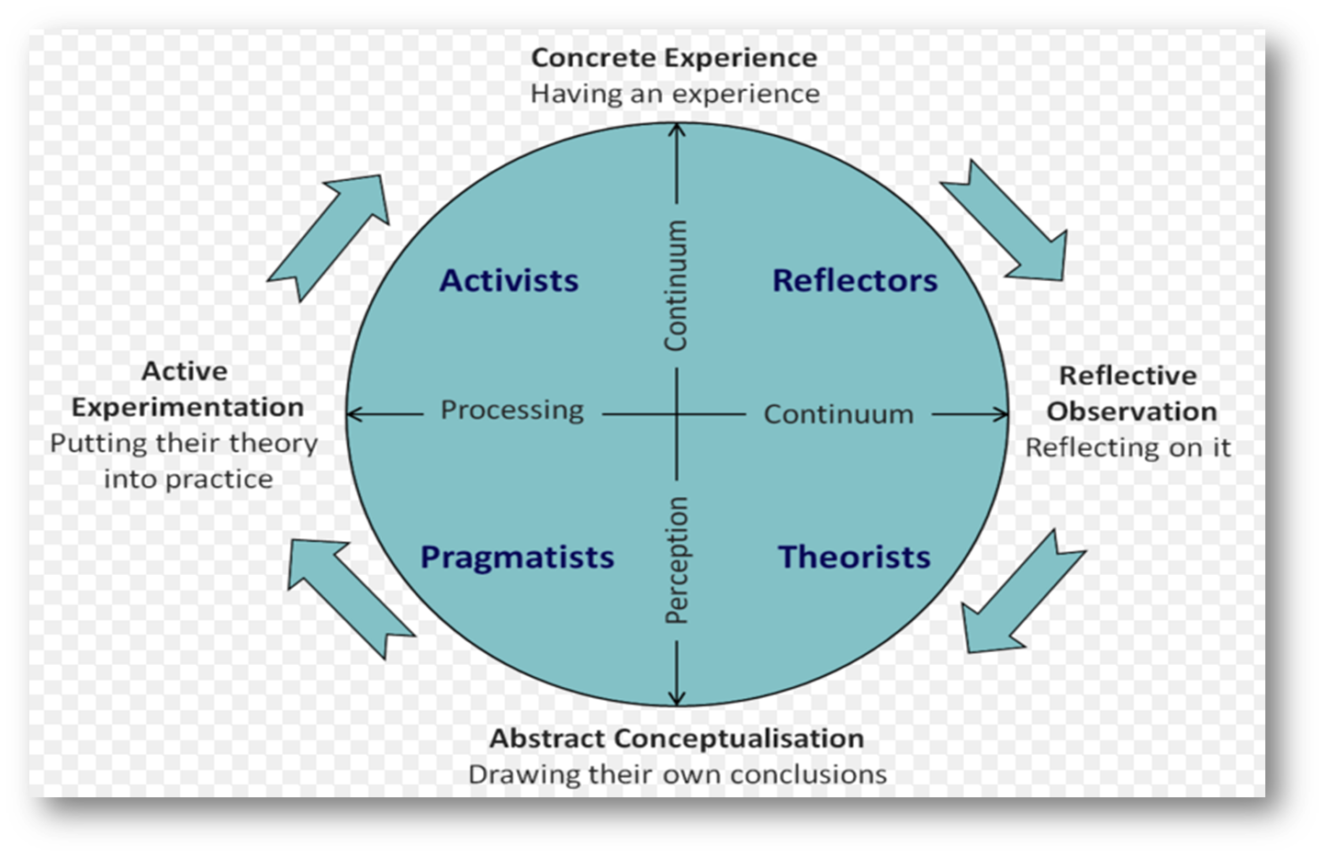

Learning styles was first developed by David Kolb (1984).
The most direct application of the model is to ensure that teaching activities give full value to each stage of the process

Slide 12
Rational
Learning styles are a preference, as such; there is no scientific evidence to suggest that choosing a particular learning style benefits a particular type of learner. (Brown, 2004)
By separating learners under different categories of learning styles, there is the strong possibility that learners themselves are restricting their own learning process. (Dunn and Dunn 1979)
Learning styles are conceptual ideas, they don’t account for what the student ‘actually’ learns. (Brown, 2004)
Learners have different ‘intelligences’, the human mind appreciates the same information in many different ways, if this is true, then learning styles are too restrictive, people cannot be wholly characterised. What works for one deemed ‘the theorist’ will not necessarily work for another ‘theorist’. (Rayner, 2007)
The idea that learning style questionnaires are less about the learning style and more like a personality test. (Sims and Sims 1995)

Slide 13
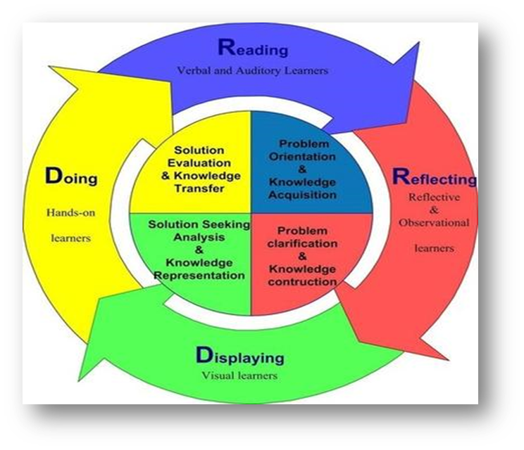
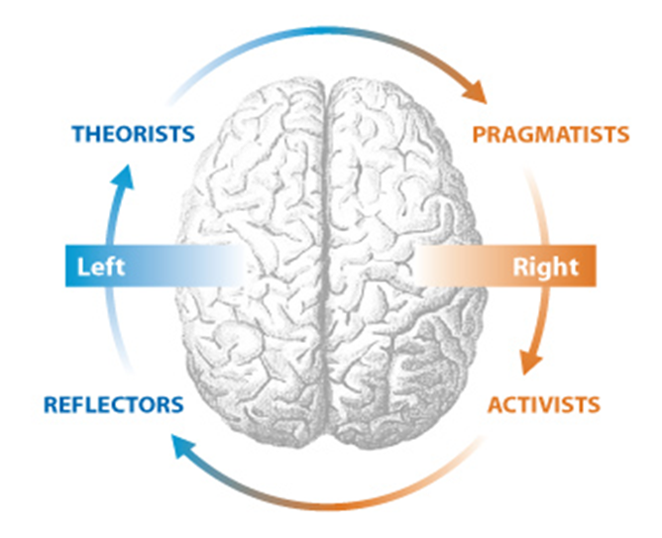
Differentiation
In order to be able to provide learners with their preferred learning delivery approach (i.e. through the incorporation of learning styles), it is considered necessary to understand how learners learn, and how this interfaces with the models of learning styles available (Honey and Mumford 1988))

Slide 14
Conclusions
Honey and Mumford’s contribution in analysing learning styles has been productive in focusing educators’ and trainers’ attention on individual differences in learning situations.
Their theoretical approach is not altogether helpful and is at times confused and confusing.
Their means of identifying individual styles may be flawed. If measurements of personality are required, there are more valid and reliable instruments around.
(If we required to find out more about trainees’ preferred ways of learning why not simply ask the trainees themselves to consider some key questions, such as;
It is suggested that the learning style questioner-LSQ is based on a model which is not sufficiently sophisticated to describe the learning that takes place in higher education.
The LSQ is defined in terms of a management trainee’s learning rather than that of a student in higher education.
Caution should be employed if adopting the LSQ to select appropriate instructional methods or to categories individual students).

Slide 15
Bibliography
Boot, R and Boxer, P, ‘Reflective Learning’, in Beck, J and Cox, C (Eds), Advance in Management – Education (Chichester: John Wilry & Sons, 1980).
Boud, D, Keogh, R, and Walker, D, (Eds), Turning Experience into Learning (London: Kogan Page, 1985).
Brown, G, How students learn (Routledge: Falmer, 2004).
Dunn, R.S. and Dunn, K.J. Learning styles/teaching styles: Should they... can they... be matched. Educational leadership (1979) , 36(4), pp.238-244.
Gardner, H, Multiple Intelligence: New Horizons ( USA, Basic Books, 2006).
Elder, L and Richard, P, The Critical Thinkers Guide to Intellectual Standers (Foundation for Critical Thinking, 2009).
Hage, J, What to Expect from Legal Logic?. In: Verheij, B. and Lodder, A.R. and Loui, R.P. and Muntjewerff Legal Knowledge and Information Systems: JURIX 2001: The Fourteenth Annual Conference (Amsterdam: IOS Press, 2001), p.77-83.
Honey, P. & Mumford, A. (1982) Manual of Learning Styles London: P Honey
PeterHoney.com [eternal link]
Kolb, D, Experiential Learning: Experience as the Source of Learning and Development (Prentice Hall, 1984).
Landau, J, L. (1981) Logic for lawyers Pacific Law Journal. 13 (1), 59-98
Pue, W, W. (2008) Legal education's mission. Law Teacher 42 (3), 270-290.
Sims, R.R. and Sims, S. J, The Importance of Learning Styles: Understanding the Implications for Learning, Course Design, and Education (Westport : Greenwood Press, 1995).
Rayner, S, A teaching elixir, learning chimera or just fool's gold? Do learning styles matter?, Support for Learning (2007), 22(1), pp.24-30.
http://www.emtrain.eu/learning-styles/
https://www.le.ac.uk/users/rjm1/etutor/resources/learningtheories/honeymumford.html

